Slide 1
Atta Mohammad of Kashmir: Obliged to Remember
Text : Angana Chatterji
Photos: IPTK
Concept & Layout: Ather Zia

Slide 2
Atta Mohammad (circa 1940-2016) was the gravedigger and caretaker of the unknown, unmarked and some mass graves at Chehal Bimyar in Baramulla District.
For those seeking to locate persons missing and disappeared and to access local knowledge and the events of history, Atta Mohammad’s commitment to remembrance rendered navigable complex modes of power that organize landscapes of subjection. An example, next of kin from Srinagar, following identification, were able to claim 10 to 15 cadavers from Chehal.
Caption: Ata Mohammad at his humble abode, 2008

Slide 3
The graveyard at Chehal is filled with loose gravel, adjacent to a boy's high school. Mohammad stated that people who were forced to bury the dead in unmarked graves live with prolonged psychosocial and physical health impacts. Many that live proximate to the graves, their dreams are animated by fear and daily life inhabited with nervousness and unease. The affect of the graves women and children is daunting.
In an interview in 2008, Mohammad told me [Angana Chatterji]: "The blood in my veins is still. Sleep is haunted with dreams of the earth, thick soil separated into graves, pressed with bodies dead from fake encounters.”
Ata Mohamad cared for the graves and circulated the details of the cadavers within the community, he said, “Out of faith, and a larger conviction of duty to the dead. Such obligation is necessary to care for the living.”
Caption: Angana Chatterji & Ata Mohammad in conversation near the graveyard

Slide 4
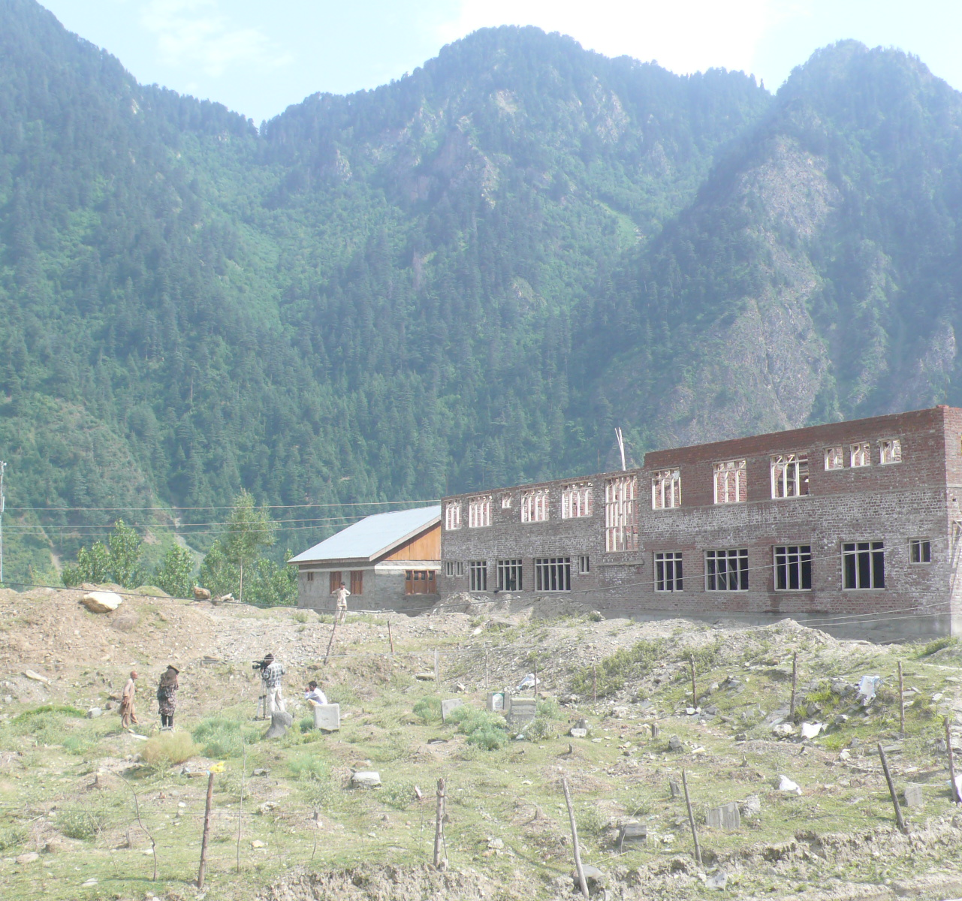
In Chehal Bimyar, International Peoples Tribunal of Kashmir (IPTK) located 132 graves. In June 2008, Atta Mohammad, then 68, stated to Angana Chatterji and Parvez Imroz that he had buried 203 bodies on a hillside adjacent to the Jhelum River between 2002-2006.
Of these, 132 graves, 126 graves were unnamed 63 graves held 2 bodies each = 126 bodies , 5 graves held 3 bodies each = 15 bodies, 64 graves held 1 body each = 64 bodies. Total = 205 bodies. Out of these (203 of which were buried by Atta Mohammad) (Chatterji and Imroz et al., BURIED EVIDENCE, 2009: 55)
Graveyard at Chehal Bimyar, Baramulla Distict

Slide 5
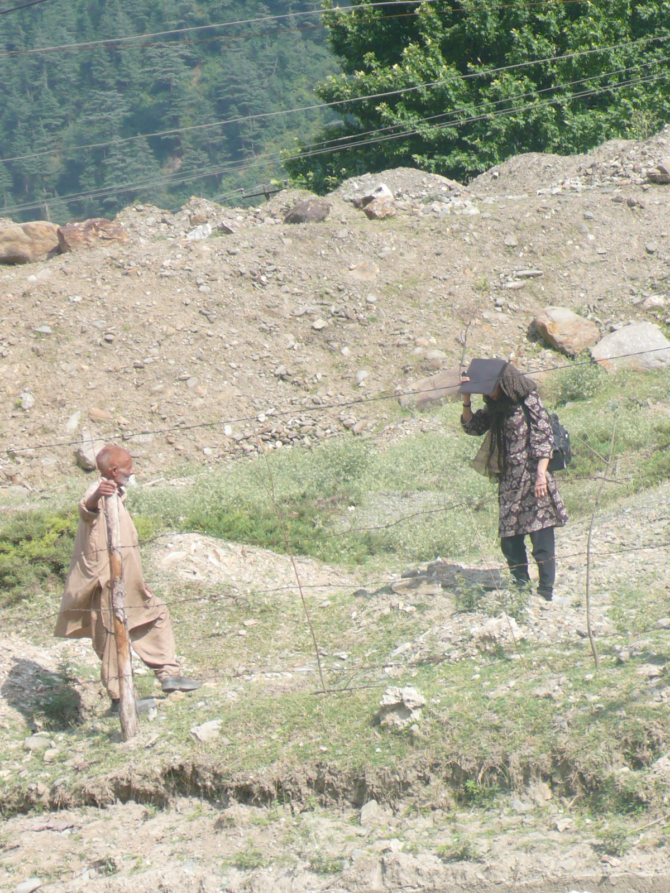
“I have been terrorized by this task that was forced upon me. My nights are tormented and I cannot sleep, the bodies and graves appear and reappear in my dreams. My heart is weak from this labor. I have tried to remember all this... the sound of the earth as I covered the graves... bodies and faces that were mutilated... mothers who would never find their sons. My memory is an obligation. My memory is my contribution. I am tired, I am so very tired.” said Ata Mohammad
(Chatterji and Imroz et al., BURIED EVIDENCE, 2009: 18)
Caption: A memory of Atta Mohammad and Angana Chatterji meeting for the first time, June 2008.

Slide 6
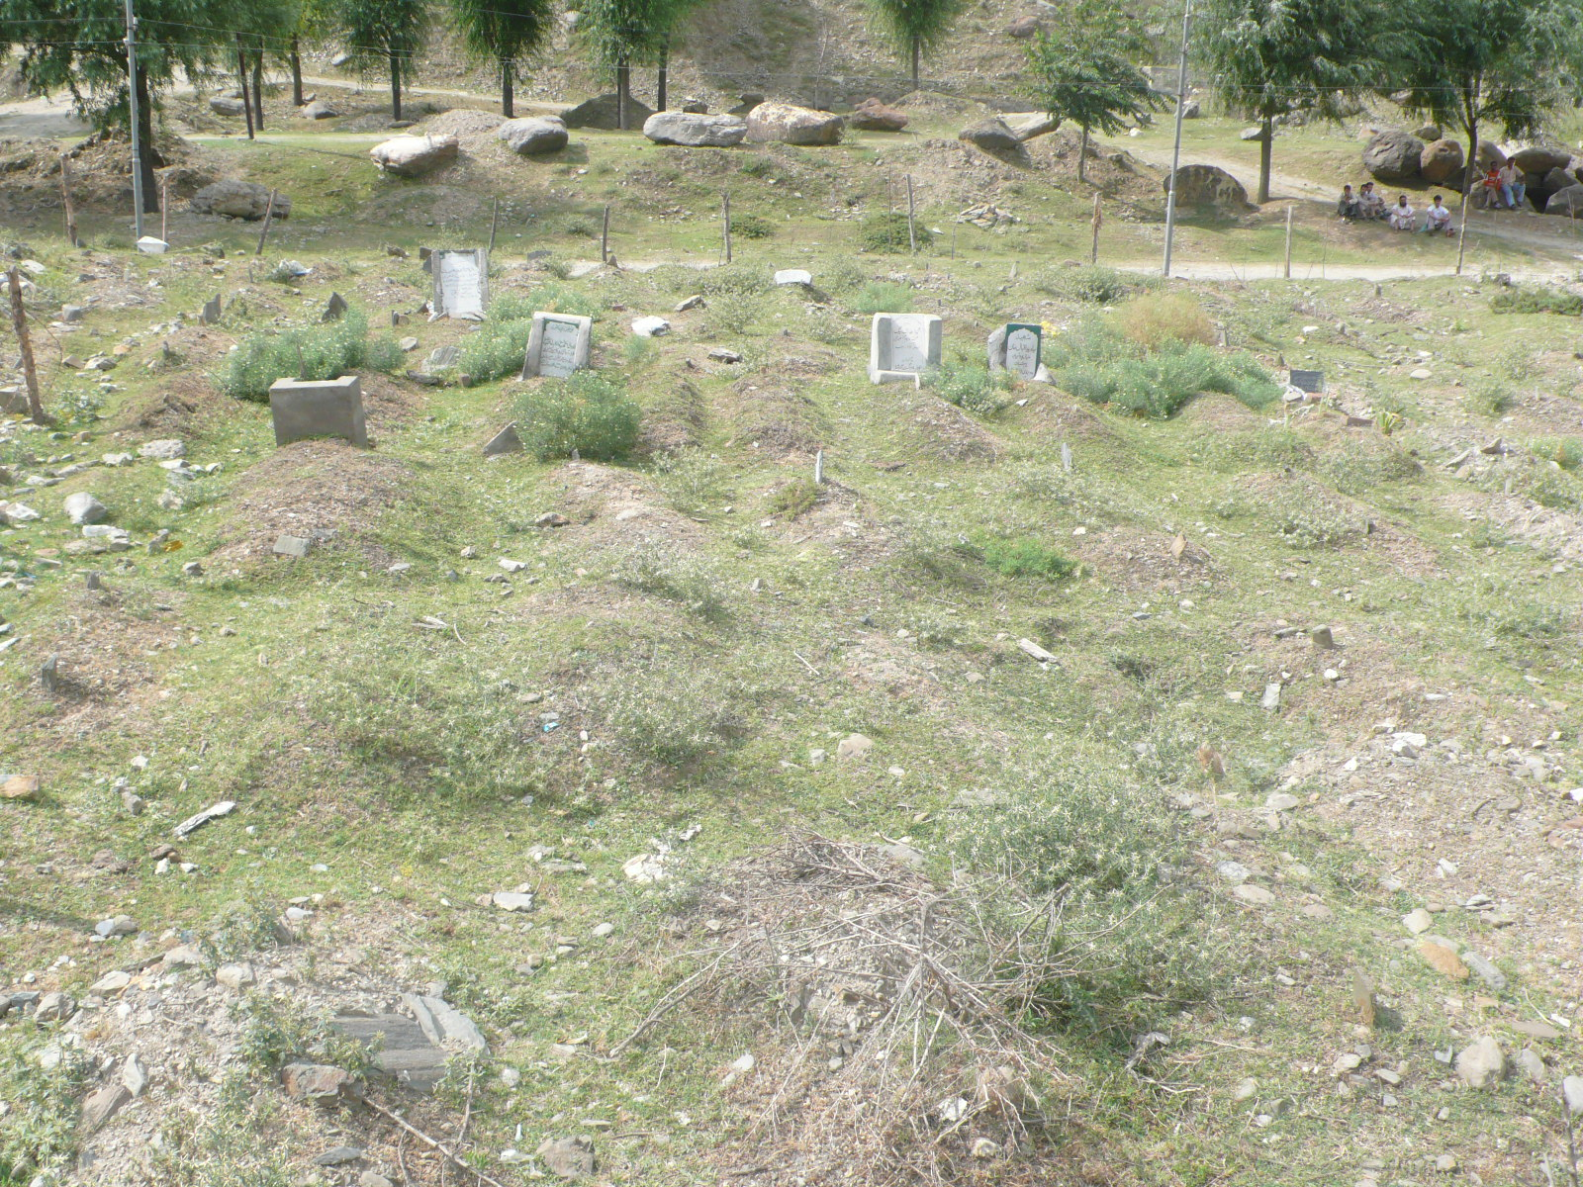
Atta Mohammad generously hosted the IPTK team at his home in June 2008, educating us about his labor in burying and caring for the graves.
Caption: A view of the Chehal graves

Slide 7
Parvez Imroz listening to local community members at Chehal, 2008

Slide 8
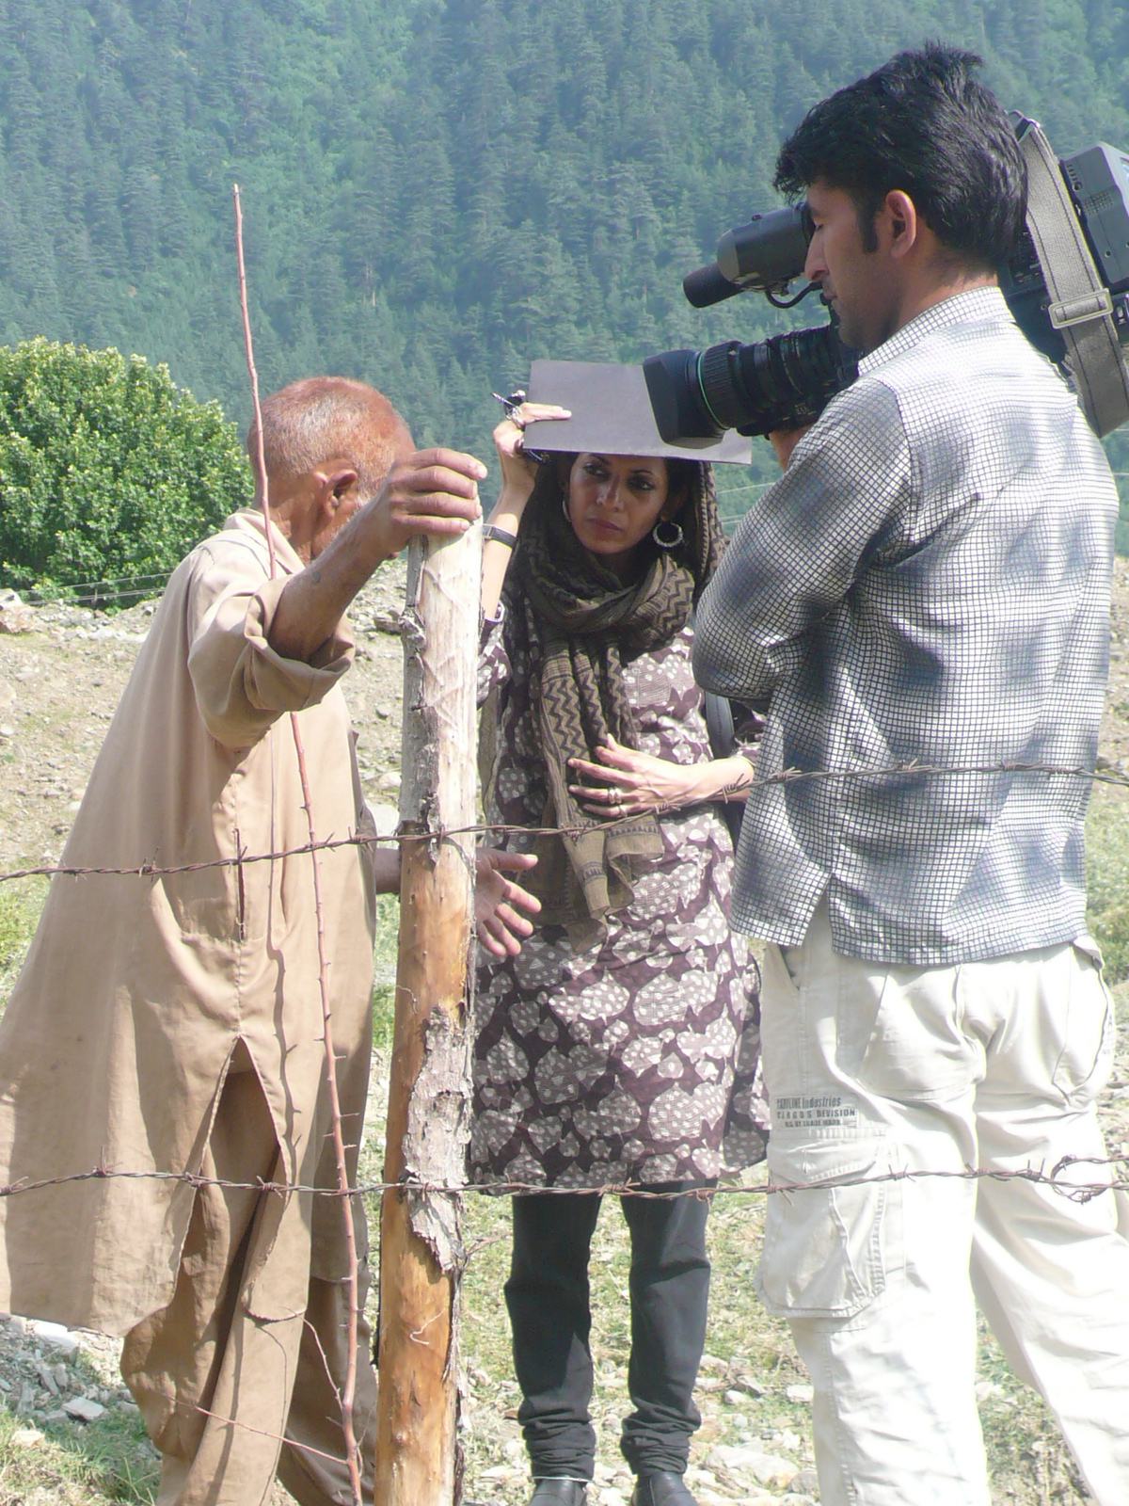
Following the publication of BURIED EVIDENCE, I [Angana Chatterji] met with Atta Mohammad a few times between December 2009 and January 2011, when visiting Kashmir. We would meet at the IPTK office at Lal Chowk. He would ask about my life, how I was doing, always generously sharing his thoughts. In a meeting on a dusty afternoon in 2010 we talked about the anticipation of death, “death-bound-ness,” as it encodes the act of living in Kashmir. and Mohammad said to me: “Living is entwined with death. The young men in the graves, they knew death even before it took them. We live among these graves. For decades, we have been forbidden from talking about them. It chokes the heart. We are also forbidden from taking about freedom. Life is lived here with the threat of death, very close to [atypical] death. Not having freedom is death, a different form of death than a 'fake encounter.' Survival in Kashmir means learning how to live with death.”
Graveyard at Chehal Bimyar, Baramulla Distict

